Slide 1
Dual-Mode and Multimode Operation

Slide 2
In order to ensure the proper execution of the system, we must be able to distinguish between the execution of operating-system code and user-defined code.

Slide 3
At the very least, we need two separate modes of operation: user mode and kernel mode (also called supervisor mode, system mode, or privileged mode).

Slide 4
A bit, called the mode bit, is added to the hardware of the computer to indicate the current mode: kernel (0) or user (1).
With the mode bit, we can distinguish between a task that is executed on behalf of the operating system and one that is executed on behalf of the user.

Slide 5
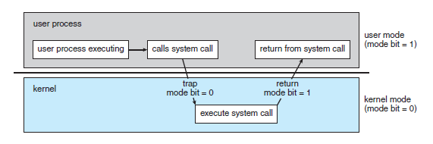
At system boot time, the hardware starts in kernel mode. The operating system is then loaded and starts user applications in user mode. Whenever a trap or interrupt occurs, the hardware switches from user mode to kernel mode (that is, changes the state of the mode bit to 0). Thus, whenever the operating system gains control of the computer, it is in kernel mode. The system always switches to user mode (by setting the mode bit to 1) before passing control to a user program.

Slide 6
We accomplish this protection by designating some of the machine instructions that may cause harm as privileged instructions.
The hardware allows privileged instructions to be executed only in kernel mode. If an attempt is made to execute a privileged instruction in user mode, the hardware does not execute the instruction but rather treats it as illegal and traps it to the operating system.

Slide 7
What is an API

Slide 8
An API is a set of programming code that enables data transmission between one software product and another. It also contains the terms of this data exchange.
Each API contains and is implemented by function calls – language statements that request software to perform particular actions and services.

Slide 9
What APIs do and How they work

Slide 10
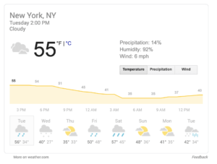
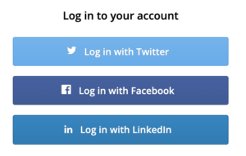

APIs are everywhere

Slide 11
Event Driven Design

Slide 12
• OS cannot trust user processes
– User processes may be buggy or malicious
– User process crash should not affect OS
• OS needs to guarantee fairness to all user
processes
– One process cannot ‘hog’ CPU time
– Timer interrupts

Slide 13
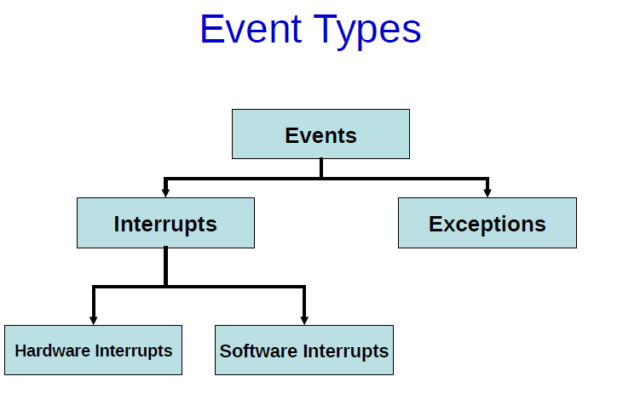

Slide 14
• Interrupts :
Raised by hardware or programs to get OS attention
• Hardware interrupts :
Raised by external hardware devices
• Software Interrupts :
Raised by user programs
• Exceptions :
Due to illegal operations

Slide 15
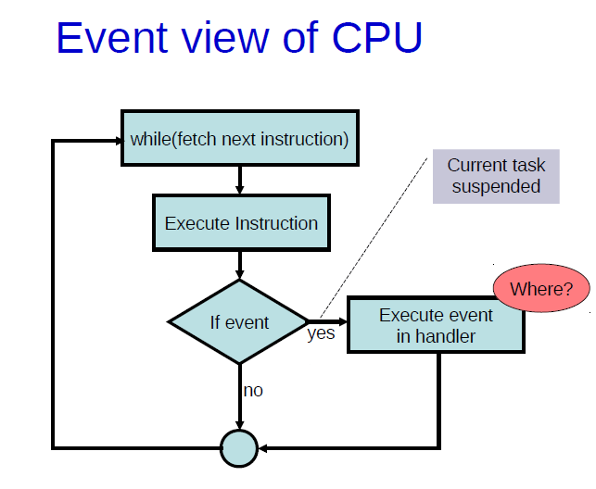

Slide 16
Hardware Interrupts

Slide 17
• Several devices connected to the CPU
– eg. Keyboards, mouse, network card, etc.
• These devices occasionally need to be serviced
by the CPU
– eg. Inform CPU that a key has been pressed
• These events are asynchronous i.e. we cannot
predict when they will happen.
• Need a way for the CPU to determine when a
device needs attention

Slide 18
Hardware vs Software Interrupt

Slide 19
